Slide 1
Scaling

Slide 2
Scales in plant ecophysiology

Slide 3
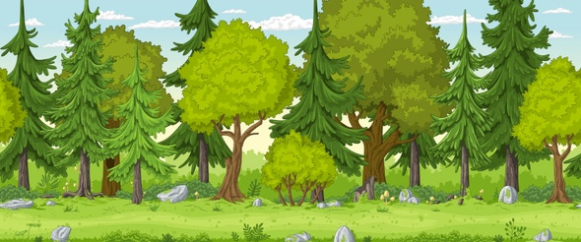
Primary two dimensions of scaling are temporal and spatial
Temporal
The timeframe over which a driver or process of interest operates
Spatial
The area over which a driver or processes of interest operates

Slide 4
Primary two dimensions of scaling are temporal and spatial
Temporal
The timeframe over which a driver or process of interest operates
Spatial
The area over which a driver or processes of interest operates

Slide 5
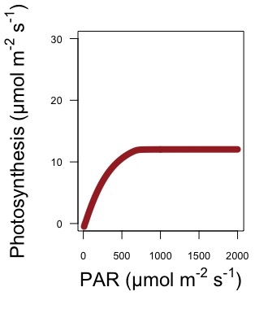
m = meters (single leaf), s = second

Slide 6
What is the timescale?
m = meters (single leaf), s = second

Slide 7
m = meters (single leaf), s = second

Slide 8
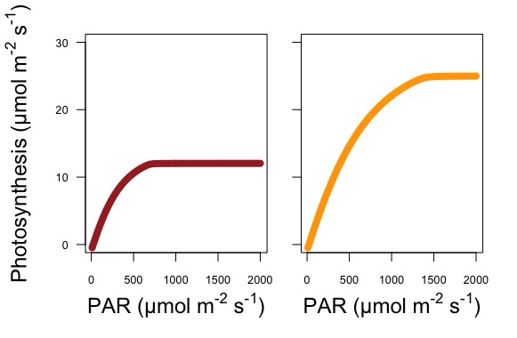
Low light acclimated
High light acclimated
m = meters (single leaf), s = second

Slide 9
Primary two dimensions of scaling are temporal and spatial
Temporal
The timescale over which a driver or process of interest operates
Spatial
The area over which a driver or processes of interest operates

Slide 10
Low light acclimated
High light acclimated
m = meters (single leaf), s = second

Slide 11
What is the spatial scale?
Is it different between panels?
Low light acclimated
High light acclimated
m = meters (single leaf), s = second

Slide 12
Low light acclimated
High light acclimated
m = meters (single leaf), s = second

Slide 13
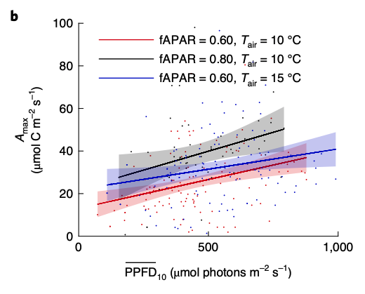
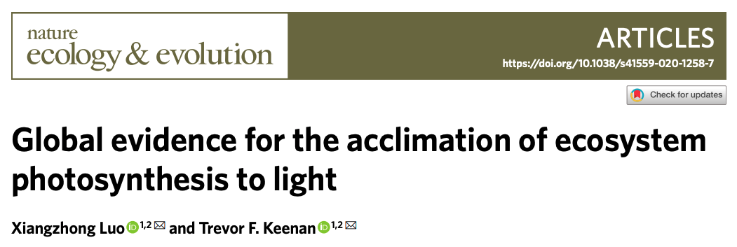
Example: testing similar processes at different scales
m = meters (single leaf), s = second, PPFD₁₀ = light over the past 10 days

Slide 14
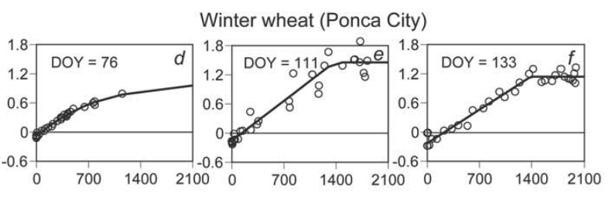
Example: testing similar processes at different scales
GPP (mg CO₂ m⁻² s⁻¹)
Light (µmol m⁻² s⁻¹)
m = meters (ground), s = second
Gilmanov et al. (2003)

Slide 15
The importance of scaling: an example exercise

Slide 16
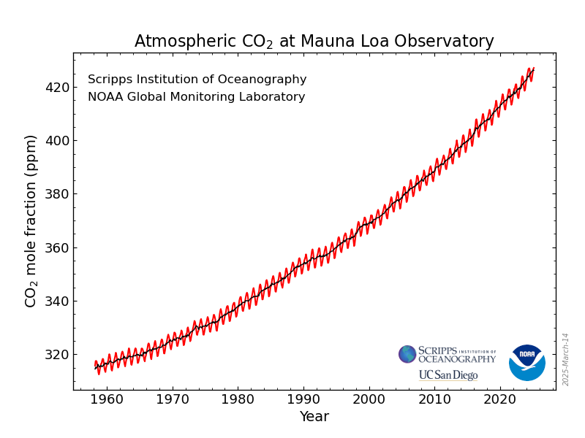
Going up 1.5 ppm / year

Slide 17
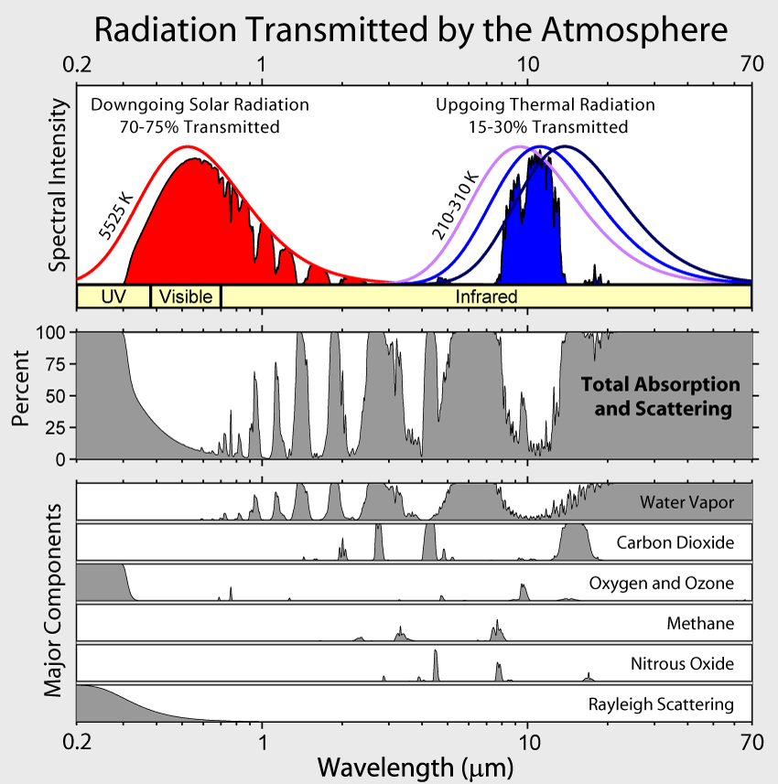

Slide 18
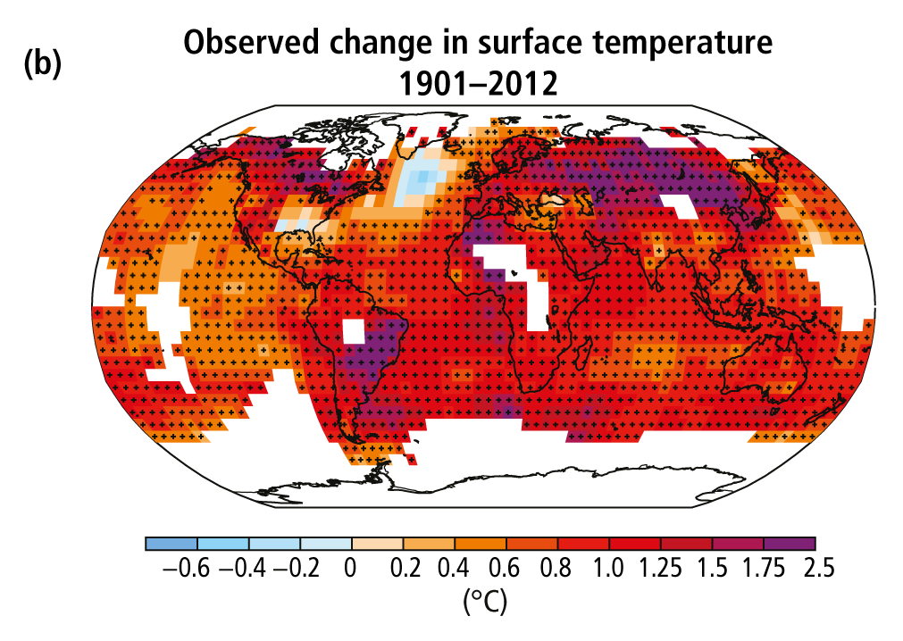
The climate is warming
Poles and land are warming the fastest
IPCC (2013)

Slide 19
O
C
O
Climate

Slide 20
O
C
O
Climate
Ecosystem
Services

Slide 21
O
C
O
Plants
Climate
Ecosystem
Services

Slide 22
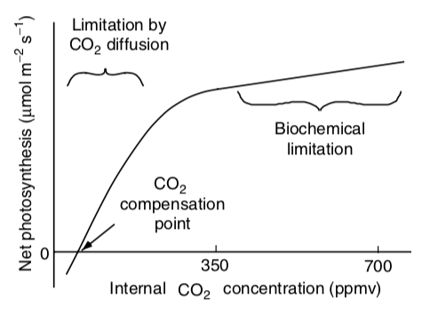

Slide 23
O
C
O
Plants
Climate
Ecosystem
Services

Slide 25
O
C
O
Plants
Climate
Ecosystem
Services

Slide 26
O
C
O
We’ve got this, right???
Plants
Climate
Ecosystem
Services

Slide 27
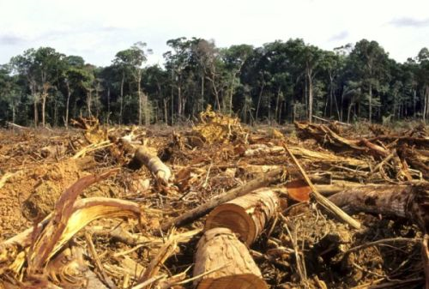

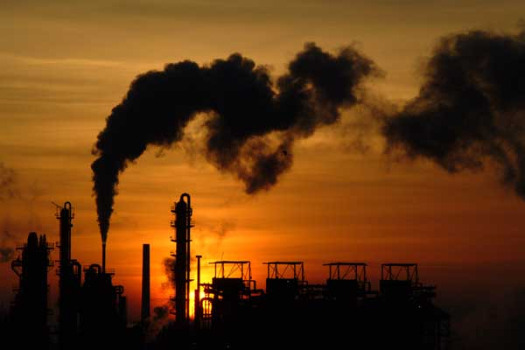
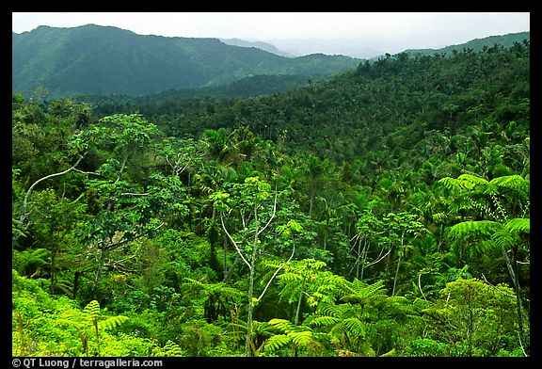

We’ve got a good handle on present-day land carbon uptake and storage (~30% of fossil fuel emissions)
46%
10%
CO₂
30%
22%
90%
LeQuere 2015
LeQuere et al. (2020)

Slide 28
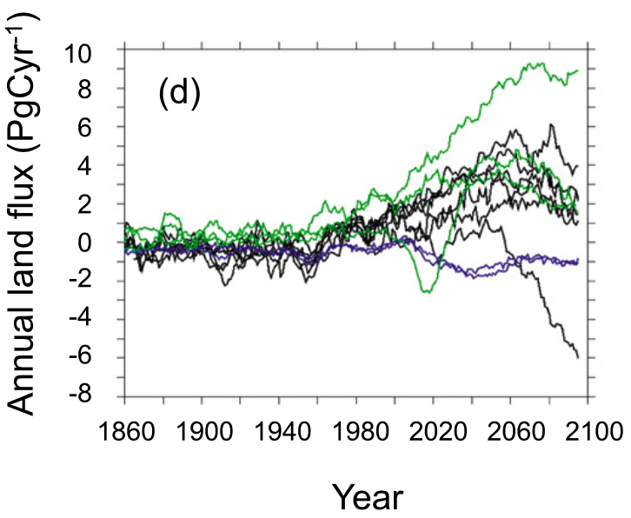
The direction and magnitude of the future land carbon sink is not known
Friedlingstein et al. (2014)

Slide 29
Land carbon sink correlates well with photosynthesis on land (r² > 0.9)
Friedlingstein et al. (2014)

Slide 30
Class activity
In teams of 3-4, answer the following question: If photosynthesis drives the land carbon sink strength and temperature and CO₂ responses of photosynthesis are well characterized, why is the future carbon sink so uncertain?
Hint: this is a scaling issue
Friedlingstein et al. (2014)

Slide 31
Working across scales: measurements

Slide 32
Scale tradeoff
Mechanisms are easier to characterize at smaller scales
As you increase scale, the details become less clear
Outcomes are easier to characterize at larger scales
As you reduce scale, it is difficult to understand all the interactions that might influence a process

Slide 33
Ecophysiological scale consideration 1: controlled versus uncontrolled conditions

Slide 34
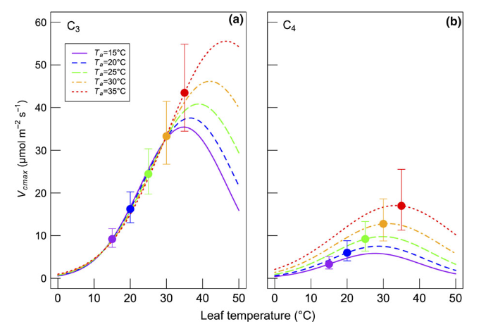
Ecophysiological scale consideration 1: controlled versus uncontrolled conditions
Controlled environment
Pro: can measure ecophysiological process response while holding all conditions constant
Smith and Dukes (2017)

Slide 35
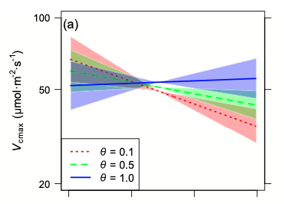
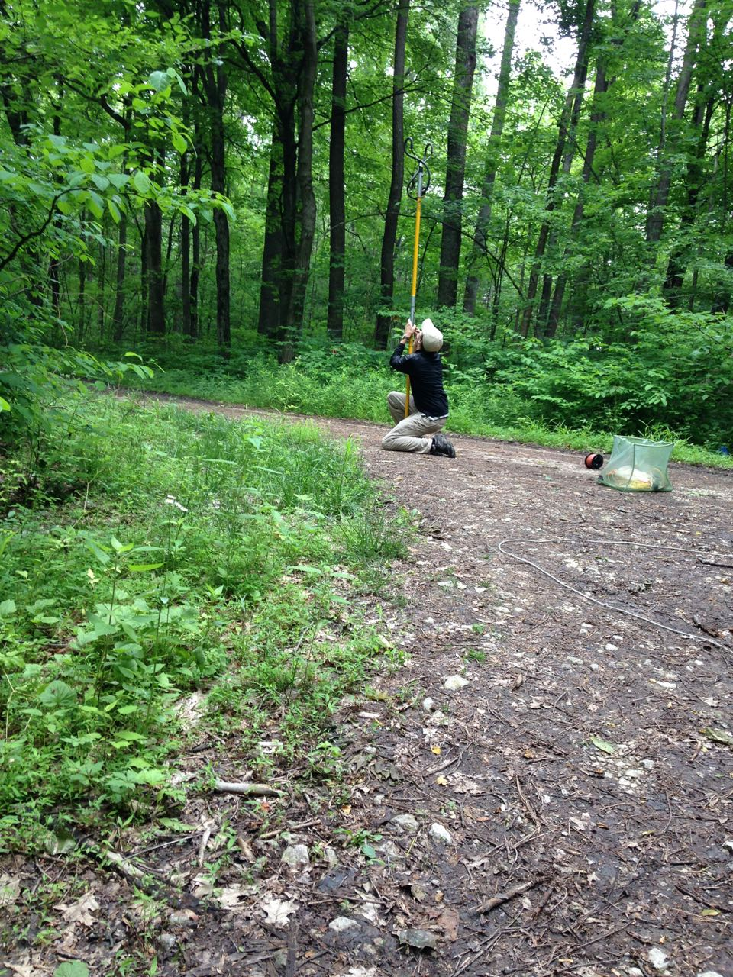

Ecophysiological scale consideration 1: controlled versus uncontrolled conditions
Controlled environment
Con: might miss important interactions, environment not in-tact
Soil moisture
Smith and Dukes (2018)

Slide 36
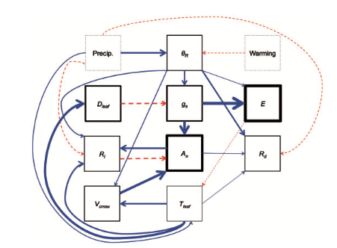
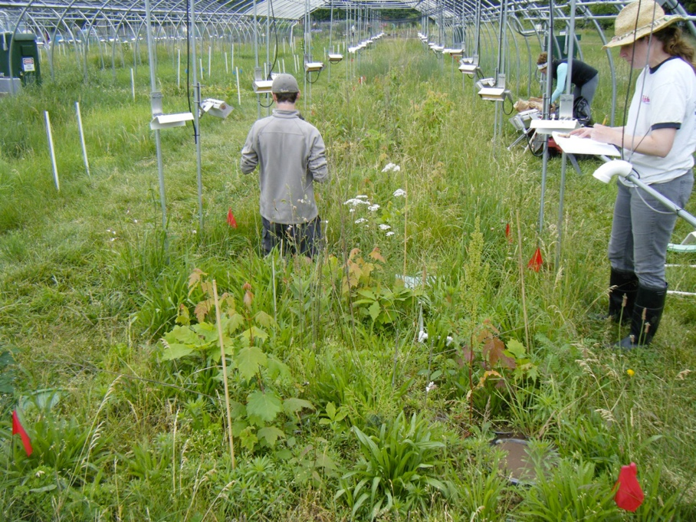
Ecophysiological scale consideration 1: controlled versus uncontrolled conditions
Middle ground: field manipulations
Pro: can manipulate in-tact environment
Con: still not truly “natural”; expensive; complex
Smith et al. (2016)

Slide 37
Ecophysiological scale consideration 2: organ versus ecosystem

Slide 38
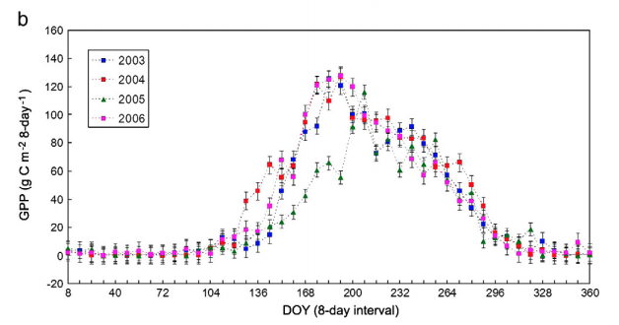
Ecophysiological scale consideration 2: organ versus ecosystem
Ecosystem-scale measurements
Pro: measure the impact on more important scale
Wu et al. (2010)

Slide 39
Ecophysiological scale consideration 2: organ versus ecosystem
Ecosystem-scale measurements
Pro: measure the impact on more important scale; lots of options

Slide 40
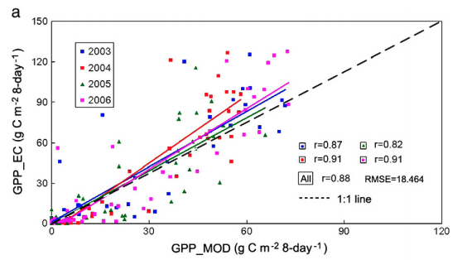
Ecophysiological scale consideration 2: organ versus ecosystem
Ecosystem-scale measurements
Con: not a direct measurement; some disagreement
Wu et al. (2010)

Slide 41
Working across scales: modeling

Slide 42
Models provide a way to assess the scalability of mechanisms (example with photosynthetic acclimation)

Slide 43
Models provide a way to assess the scalability of mechanisms
Steps involved
Evaluate process mechanisms under highly controlled conditions (small scale)

Slide 44
Smith and Dukes (2017)

Slide 45
Models provide a way to assess the scalability of mechanisms
Steps involved
Evaluate process mechanisms under highly controlled conditions (small scale)
Develop a theory for process and it’s environmental response

Slide 46
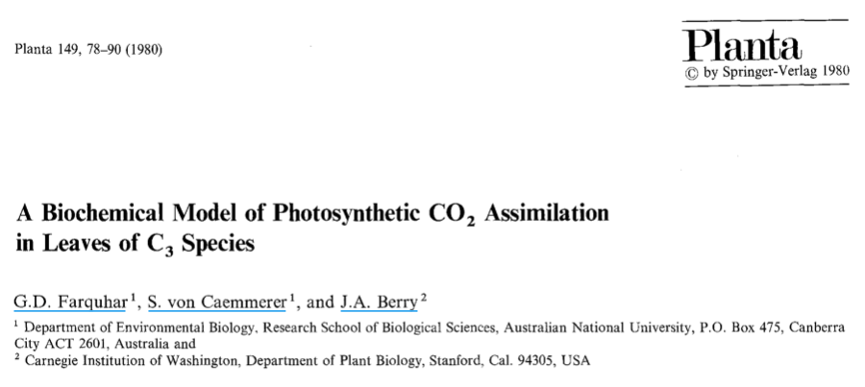
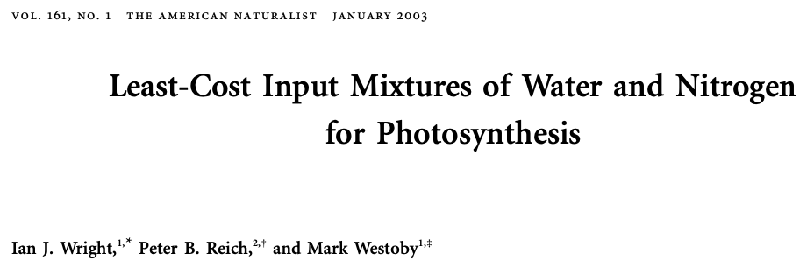

Slide 47
Models provide a way to assess the scalability of mechanisms
Steps involved
Evaluate process mechanisms under highly controlled conditions (small scale)
Develop a theory for process and it’s environmental response
Quantify the theory and build a model

Slide 48
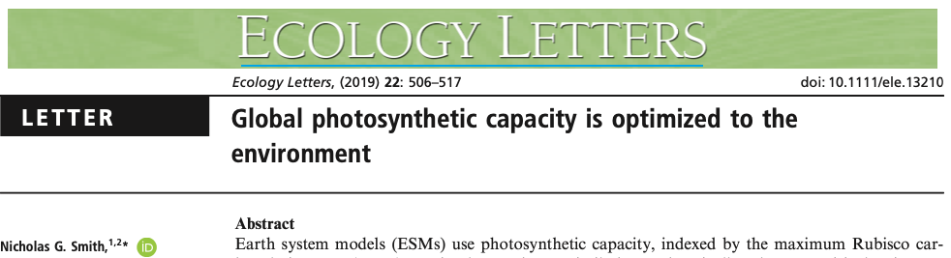
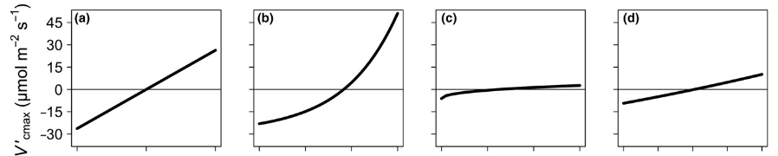

Slide 49
Models provide a way to assess the scalability of mechanisms
Steps involved
Evaluate process mechanisms under highly controlled conditions (small scale)
Develop a theory for process and it’s environmental response
Quantify the theory and build a model
Simulate similar or connected processes that can be measured at larger scales

Slide 50
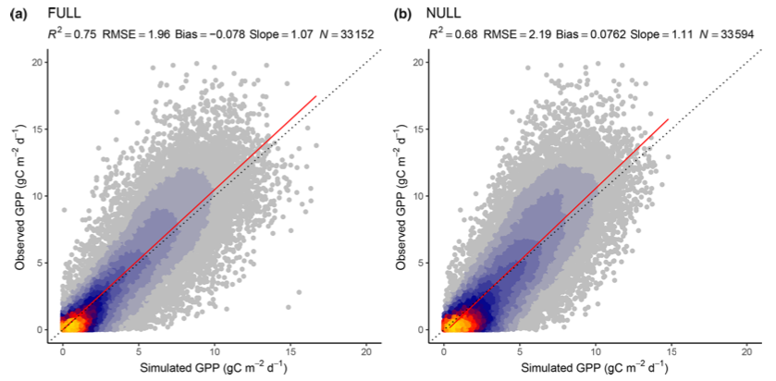
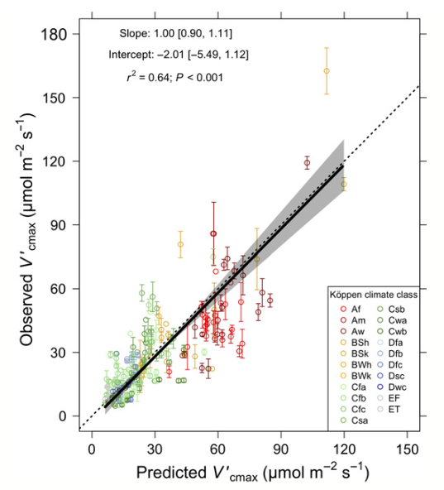
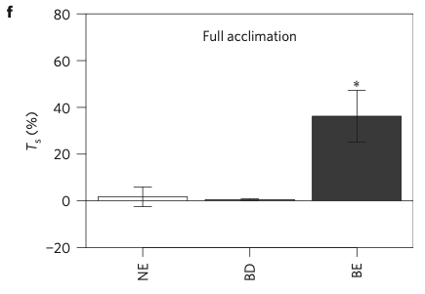
Stocker et al. (2020)
Smith et al. (2019)
Smith et al. (2016)

Slide 51
Improved scaling: coordinated research networks

Slide 52
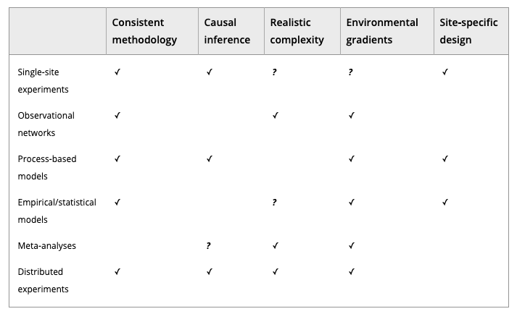
Borer et al. (2013) Meth. Ecol. Evo.

Slide 53
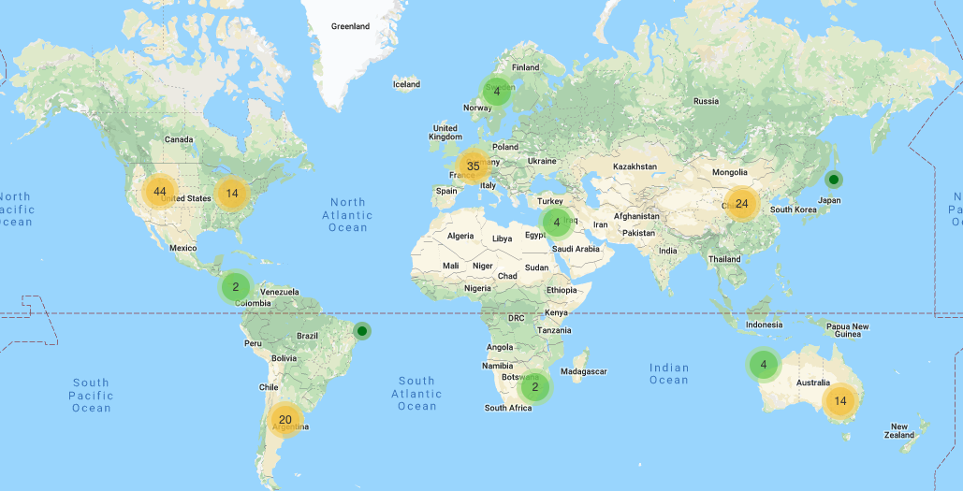
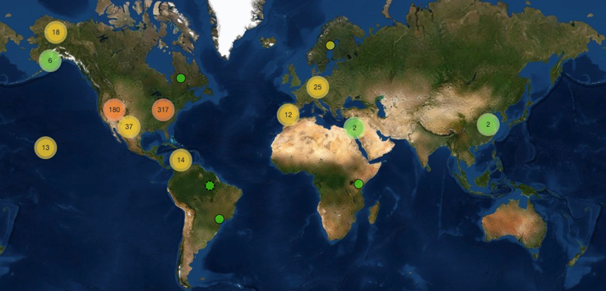
PhenoCam
Network

Slide 54
The National Ecological Observatory Network (NEON)

Slide 55
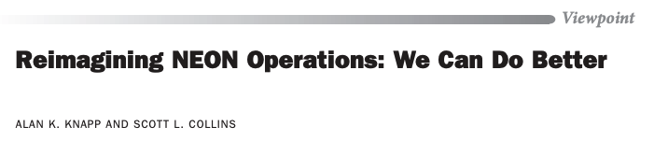
The National Ecological Observatory Network (NEON)
BioScience (October 2019)

Slide 56
Long-term ecological and agricultural research sites (LTER and LTAR)
**Measurements not coordinated**

Slide 57
Future predictions: large-scale models

Slide 58
Land surface models
UCAR

Slide 59
Earth System Models
Dr. Kaitlin Naughten

Slide 60
Future predictions: realism versus reliability

Slide 61
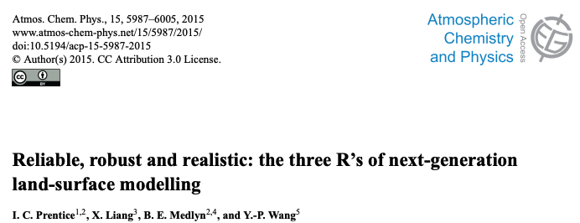
Adding processes to models may improve their realism…

Slide 62
…but may also make them more unreliable and uncertain

Slide 63
Literature review consideration: What scale(s) are you evaluating?

